Slide 1
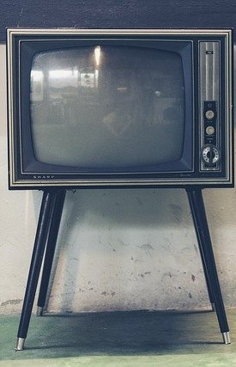
LECTURE THREE: FUNDAMNENTAL CONCEPTS OF TELEVISION
ET 8105 – Television Systems

Slide 2
Scanning
Scanning is the process of extracting signals pertaining to the individual elements of a picture (pixels) in quick succession one after the other.
When an image of a scene falls on the surface of a photosensitive target of a semi-conductor, an image in the form of electrical charge is formed due to generation of electrons; more electrons for the brighter pixels and less electrons for the less bright pixels.
These electrons are removed by a positive potential, resulting in a charge image on the surface of the target.

Slide 3
This charge image is the replica of the optical image of the scene because the charge on every point on the surface of the target is proportional to the intensity of light in the corresponding pixel.
Each point of charge on the surface of the target may be called a pixel of charge on the analogy of pixels of a picture.
It is this charge image which should be converted into electrical signal.
For this, individual pixels of the charge image are explored in quick succession with the help of an electronic beam.
Scanning of the charge image converts the charges on the surface of the target into electrical signal varying in time frame, called video signal.

Slide 4
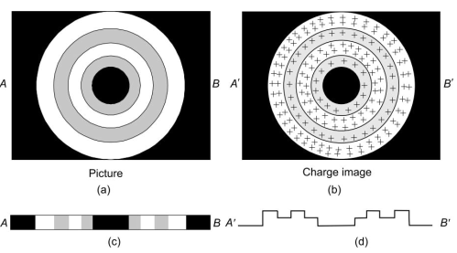
A simplified illustration of formation of charge image
Original picture
Charge image of the picture
Brightness levels in the picture along horizontal line AB on the picture
Positive charge along the corresponding scanning line A’B’ on the charge image

Slide 5
Similar scanning is done at the receiver.
There, the video signal is used to change the strength of the scanning electronic beam which glows the phosphor elements on the surface of a fluorescent screen.

Slide 6
Need of Scanning
To transmit all the variations of light present in the space of a picture at a single instant of time, thousands of channels would be needed.
It is not feasible to use so many channels to transmit a single programme
Thus, the first requirement for transmitting the variations of light in a picture is to convert them into signals varying with time so that there is only a single variation at any one instant.
Hence the need of scanning.

Slide 7
Sawtooth Currents for Scanning
Horizontal and vertical scanning of the charge image in a camera tube and of the phosphors on the fluorescent screen of a picture tube is accomplished by deflecting a well focused spot of the electron beam horizontally from left to right and vertically from top to bottom.
Horizontal scanning is fast, it takes 64 μs for one scanning line.
Vertical deflection is slow and takes 20,000 μs (or 20 ms) in deflecting the beam from top to bottom.

Slide 8
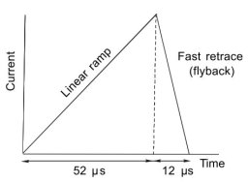
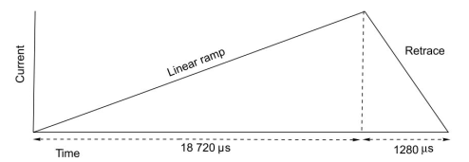
Sawtooth current for vertical deflection
Sawtooth current for horizontal deflection
For horizontal and vertical deflections, sawtooth currents are made to flow in the deflection coils in the respective camera tube at the transmitter, and in the picture tube at the receiver.

Slide 9
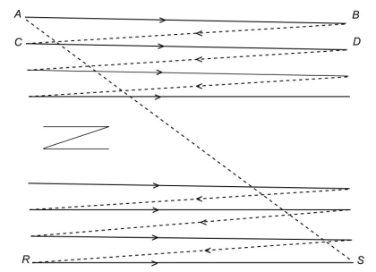
Progressive Scanning
When one cycle of vertical sawtooth current completes scanning of one frame and the next cycle starts scanning of a new frame, it is called progressive scanning.
Progressive scanning is like reading a book, with each line sloping downward.
Progressive scanning

Slide 10
Disadvantages of Progressive Scanning
In progressive scanning, 25 frames per second are scanned in European system.
When the scanning beam flips from bottom to the top of the picture frame, it takes about 1280 μs.
This retrace of 1280 μs duration is blanked on the screen of the picture tube and so the screen appears black during this time.
When a programme is being displayed, dark interruptions of blanking between bright pictures occur at 25 per second.
As persistence of vision is more for dark light, these interruptions become visible as flicker on the screen

Slide 11
If the speed of scanning is doubled (50 frames per second) flicker would be removed, but bandwidth will increase.
Increase in bandwidth is not desirable and hence progressive scanning is not used in broadcast systems.
The problem of reducing flicker without increasing the bandwidth has been solved by scanning each frame twice.
The scanning process which allows each frame to be scanned twice is called interlaced scanning.

Slide 12
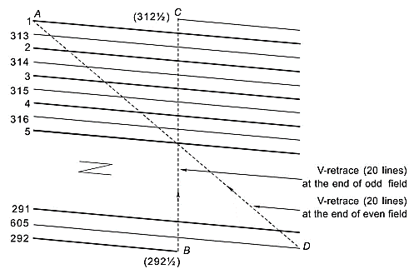
Interlaced Scanning
In interlaced scanning, there are two sequences of scanning for each frame.
Scanning lines of one sequence occur in between the lines of the other sequence.
1280 μs (equal to 20 scanning lines) are lost (blanked) in taking the retrace from B to C
Interlaced scanning

Slide 13
The lines of the second sequence fall in between the lines of the first sequence.
Through interlaced scanning, the number of interruptions becomes 50 per second in European system while complete frames are scanned at 25 frames per second.
Thus this technique does not increase the scanning speed but removes flicker by doubling the number of interruptions.
Consequently, bandwidth is conserved while flicker is removed.
Interlacing error will occur if the lines of even field are not exactly in the middle of the lines of odd field.

Slide 14
Fields
Each sequence of scanning in the interlaced scanning method is called a field.
Odd numbered sequences are called odd fields, and even numbered sequences are called even fields.
Two adjacent pixels on a vertical line in a picture are scanned , not by adjacent lines, but by lines separated in time interval of 20 ms in interlaced scanning.
However, due to the persistence of vision, the picture formed will not be distorted.
Picture due to odd field will persist when picture due to even field is being constructed on the screen.

Slide 15
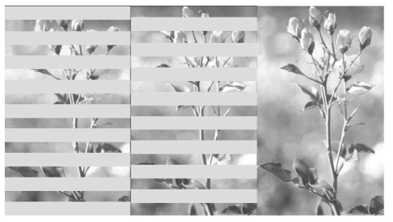
Glow of picture elements on odd and even fields

Slide 16
Frame, Field and Line Frequencies
For the scanning rate of 25 frames per second, there are two fields per frame making the number of fields per second to be 50.
This number has been chosen to be equal to the electric mains frequency so that the beat frequency between electric mains and fields is zero.
Variations in the mains would have resulted in a slow moving bar from top to bottom across the picture in the receiver.

Slide 17
Active Lines
All the scanning lines are not visible on the screen due to blanking during the retrace period.
The actual lines which reproduce pixels are called active lines.
The number of active lines (N_{A} ) is equal to the total scanning lines per frame (N_{T} ) minus the lines lost in vertical blanking ( N_{L} ), as expressed by
N_{A} = N_{T} - N_{L}

Slide 18
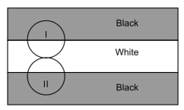
Kell Factor
Pixels are not arranged in an orderly manner in a picture.
These are distributed rather randomly.
Hence a spot of the scanning beam may cover partly two pixels.
Beam Spot I partially covers black and partially white.
So the resultant luminance of this spot would be grey (white + black = grey). Similarly Spot II would give grey.
Kell effect

Slide 19
Thus instead of giving two signal outputs (black and white), the two spots give only one signal output (grey).
The distinction between two pixels will not be reproduced.
It is called Kell effect.
Had the Spot I been confined to black area only and Spot II to white area only, two distinct pixels would have been reproduced.
But misalignment results in only one intensity making the two pixels indistinct.
Thus the Kell effect produces degradation in the resolution of individual pixels.

Slide 20
Experimentally, it has been found that about 25 to 35% pixels are lost due to Kell effect.
This means that only 65 to 75% of the active lines are responsible for distinguishing the individual pixels.
Thus, effective lines are worked out by multiplying the active lines by a factor of 0.65 to 0.75 (mean value = 0.7)
This factor is called Kell factor and is used in estimating the actual resolution achieved in TV pictures.
Smaller the size of the beam’s spot, less will be the Kell effect and higher the Kell factor.

Slide 21
Resolution
Resolution means ability to distinguish between closely spaced pixels.
Greater the number of pixels, smaller would be their size and hence higher would be the resolution.
High resolution will thus enable us to distinctly see closely spaced small objects e.g. wrinkles on a face, hair of the eyebrows, veins on leaves, etc.

Slide 22
Vertical Resolution
The number of pixels on a vertical line on the screen will be equal to the number of horizontal lines.
In a 625 lines system, 625 pixels will glow on a vertical line.
For effective resolution, this number will be reduced by the lines lost in vertical blanking and multiplied by the Kell factor (K ).
This will then give vertical resolution, (RV ) as expressed as
R_{V} = (N_{T} – N_{L}) K = N_{A} K
Vertical resolution will make vertically located close features of a picture visible distinctly clear.

Slide 23
Horizontal Resolution
If the aspect ratio is A, the number of pixels on a horizontal line would be equal to R_{V} multiplied by A.
This is called horizontal resolution (RH ) and is given by
R_{H} = R_{V} x A
Horizontal resolution will make horizontally located close features of a picture visible distinctly clear.
For non-digital systems, A is 4/3. (for wide dimension digital TV systems, A is 16/9).
Generally, resolution of a TV system is expressed in terms of vertical resolution.

Slide 24
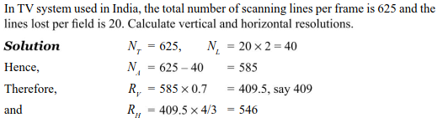
Example 01

Slide 25
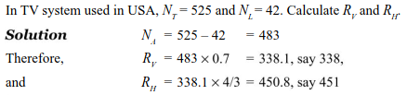
Example 02

Slide 26
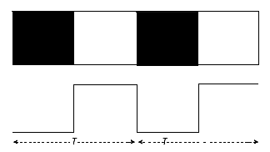
Bandwidth
Bandwidth is the highest video frequency related to the time taken in scanning two adjacent pixels.
Consider a figure showing 4 successive pixels and the corresponding 2 cycles of brightness.
Time period T is the time taken in scanning one cycle of two adjacent pixels.

Slide 27
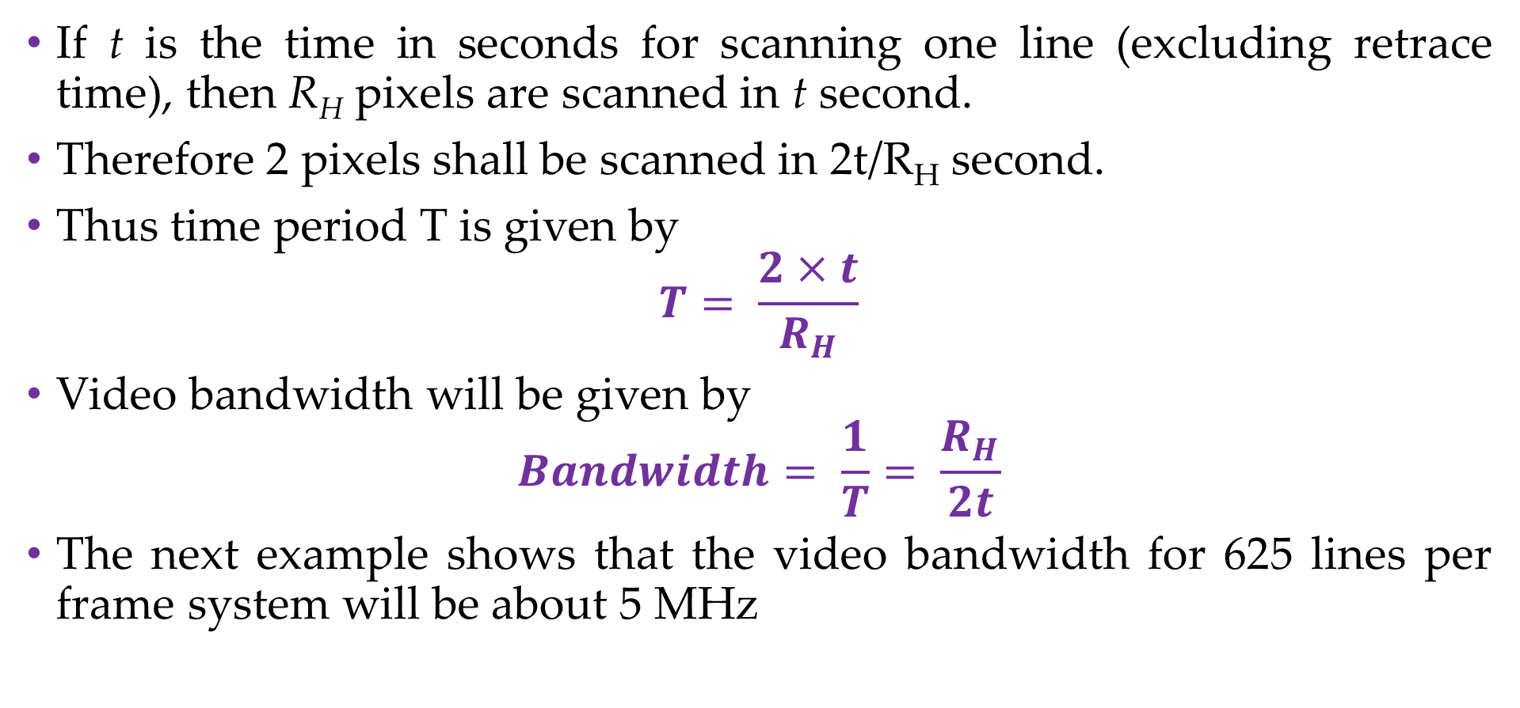
If t is the time in seconds for scanning one line (excluding retrace time), then R_{H} pixels are scanned in t second.
Therefore 2 pixels shall be scanned in 2t/R_{H} second.
Thus time period T is given by
$$T= \frac{2×t}{R_{H}}$$
Video bandwidth will be given by
$$Bandwidth= \frac{1}{T}= \frac{R_{H}}{2t}$$
The next example shows that the video bandwidth for 625 lines per frame system will be about 5 MHz

Slide 28
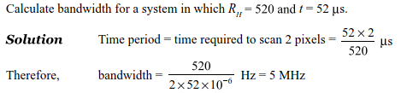
Example 03

Slide 29
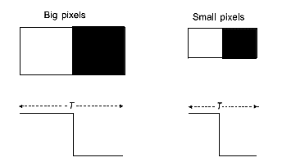
Relationship Between Resolution and Bandwidth
Smaller the size of pixels that can be reproduced, better would be the resolution.
At the same time, smaller the size of pixels, less would be the time taken in scanning two adjacent pixels and hence higher the bandwidth.
Thus the resolution and bandwidth depend on each other. Higher bandwidth gives better resolution

Slide 30
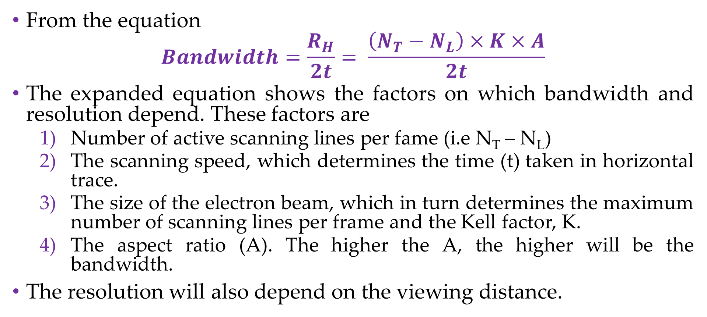
Factors on Which Bandwidth and Resolution Depend
From the equation
$$Bandwidth=\frac{R_{H}}{2t}= \frac{\left(N_{T}−N_{L}\right)×K×A}{2t}$$
The expanded equation shows the factors on which bandwidth and resolution depend. These factors are
Number of active scanning lines per fame (i.e N_{T} – N_{L})
The scanning speed, which determines the time (t) taken in horizontal trace.
The size of the electron beam, which in turn determines the maximum number of scanning lines per frame and the Kell factor, K.
The aspect ratio (A). The higher the A, the higher will be the bandwidth.
The resolution will also depend on the viewing distance.

Slide 31
Bandwidth of the Baseband Signal
This pertains to the frequency through which information varies.
Example, audio signal’s frequency range is 16Hz to 20,000 Hz.
Thus, an ideal audio circuit should have flat response up to 20 kHz.
For telephone conversation, bandwidth is 4 kHz, for normal radio broadcast, 5 kHz, and for high fidelity, 15 kHz.
Video variation can go up to 5 MHz.
Colours have much lower bandwidth due to the limitation of eyes to see colour. The usual bandwidth for colour is less than 1.5 MHz.

Slide 32
Signal Bandwidth
This is the bandwidth which is occupied by the baseband signal in a radio frequency spectrum.
A baseband signal is transmitted by modulating a radio frequency carrier.
In the modulated wave, the baseband information is contained in
sidebands.
Sidebands are equally spaced in frequency from the carrier. In amplitude modulation, there is one pair of sidebands, but in frequency modulation there may be many pairs.
Amplitude modulation is used for video signal, whereas Frequency modulation for audio signal.

Slide 33
Synchronisation
Scanning is done at the transmitter as well as at the receiver. Scanning in both transmitter and receiver should be identical.
It should start at the same instant and at the same point of the screen at the receiver at which it starts in the transmitter.
This is called synchronisation between the transmitter and the receiver.
If the scanning is not synchronized, the picture would be totally displaced, and the object which are on the top of the original picture may appear on the bottom in the reproduced picture due to lack of vertical synchronization.
Lack of horizontal synchronisation will split the picture diagonally.

Slide 34
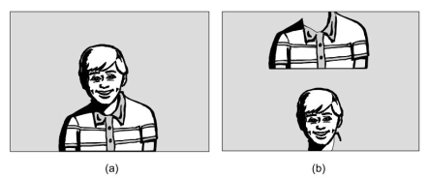
Effect of lack of synchronisation: (a) Original picture as transmitted and (b) Displaced picture in the receiver due to lack of vertical synchronisation

Slide 35
To ensure synchronisation between transmitter and receiver, synchronisation pulses (called sync pulses) are used to start sawtooth signal.
Separate sync pulses are required for horizontal scanning and vertical scanning.
The sync pulse triggers the concerned sawtooth signal generator for every sawtooth cycle in the transmitter.
Thus frequencey of the sync pulse is the same as that of the scanning lines.
For horizontal scanning the sync pulse (called H-sync) appears every 64 μs, i.e. its frequency of occurrence is 15 625 pulses per second.
For vertical scanning, sync pulse (called V-sync) appears every 20 ms. Thus its frequency is 50 Hz.

Slide 36
Blanking
Blanking pulses are used to blank (or cut-off the cathode ray tube) during retrace period of horizontal scanning as well as vertical scanning process in the transmitter and also in the receiver.
In the absence of blanking, retrace will become visible on the screen and will cause distortion in the picture.
In actual practice, the sync pulse is placed over the respective blanking pulse by time division multiplexing, using monostable multivibrators.

Slide 37
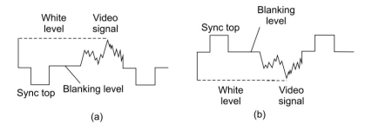
Compoite Video Signal
Picture information (video signal) is not transmitted alone.
Along with it are transmitted blanking pulses and sync pulses.
The signal containing all these components is called CVS (composite video signal).
Composite video signal
of + ve polarity and
(b) of – ve polarity

Slide 38
+Ve and –Ve Polarities of CVS
The composite video signal can be represented in two forms, namely positive polarity and negative polarity.
For positive polarity, brighter the scene, higher is the amplitude of the video signal.
Blanking level is zero level.
Below zero is the sync pulse.
Hence sync top is at the most negative point.
For negative polarity, brighter the scene, smaller is the amplitude.
Here, sync pulse is positive, above the blanking level
Black is just below the blanking level, white is near the bottom.
Brighter the scene, lower is its level below the blanking level

Slide 39
Advantages of Negative Modulation
In most of the TV systems, negative polarity is used to modulate the video carrier.
When the baseband of negative polarity is used to modulate the RF carrier, the modulation is called negative modulation
Advantages of negative modulation include
The noise pulses in the transmitted signal shall increase the amplitude of the carrier which will move towards the black. Thus noise falling in the dark grey or black region will not cause irritation.
- The entertainment value of the picture will not be adversely affected.
- In positive modulation, white blobs will be caused in the picture due to random noise signals.

Slide 40
Carrier amplitude will remain low for most of the time as the signal content is more in white than in black. This will cause saving in transmission power.
In negative modulation the voltage of the blanking pulse is of fixed level which depends on the carrier strength. This level forms the reference level for deriving automatic gain control (AGC) voltage dependent on the carrier strength.

Slide 41
Disadvantages of Negative Modulation
Impulse pulse may disturb the H-sync and hence H-sychronisation may be disturbed for a short duration. This effect is reduced by using automatic frequency control in H-sweep circuits in the receiver.
Picture tube needs positive polarity between control grid and cathode. So negative polarity of video signal is to be reversed before feeding to the control grid.
- In case of any lapse in this, the picture would appear as a negative picture on the screen, i.e. white portions appearing black and the black portions, white.
The advantages outweigh the disadvantages and hence negative modulation is used in almost all TV systems.

Slide 42
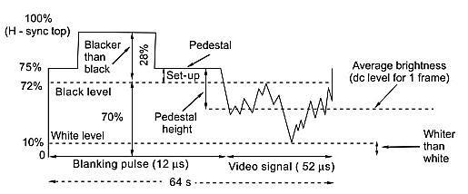
Voltage Levels in CVS

Slide 43
Percentage of Carrier - For modulated signal, the levels of various pulses are represented in terms of percentage of carrier level
For positive polarity
Sync top is at 0%
Blanking level at 25%
White level at 90% and
Whiter than white level goes up to 100%
For negative polarity
Sync top is 100%
Blanking level 75%
White level 10% and
Below it is whiter than white

Slide 44
The Various Levels in CVS
Pedestal Level – It is also called blanking level.
It is represented by 75%of the carrier signal in negative modulation.
It is a fixed level and is treated as reference.
Pedestal Height – Height of the pedestal level from the level of average intensity of the picture frame.
Black Set-up – Represents the difference between the pedestal level and the black level. In modulated signal it is 3 – 5% of the carrier
Blacker than Black – Signal beyond the black level (including black set-up and the sync pulse). It extends from 72% to 100% of the carrier.

Slide 45
Whiter than White – Signal below 10% up to zero of the carrier.
Besides the video signal, the components of the composite signal consist of the horizontal (or H–) blanking pulse and vertical (or V–) blanking pulse.
Sync pulses are needed at the end of horizontal and vertical traces to trigger the respective scanning oscillators.
During the trace (or forward scan), the video signal changes between white and black levels through grey levels, depending on the variation of brightness in the picture.
With –ve polarity of video signal, the portion above black is called blacker than black and is occupied by the sync pulse, and the black set-up.

Slide 46
Modulation Requirements for TV
Composite video signal cannot be transmitted as such to long distances for the following reasons:
Video signal’s frequency starts from as low frequency as a few Hz. A signal of such low frequency will need a transmitting antenna hundreds of kilometers long, which is not feasible.
Different video programs being in the same frequency range will clash with each other.
These difficulties are solved if we use a radio frequency carrier to carry the video signals

Slide 47
The radio frequency carrier is in very high frequency range or ultra
high frequency range for TV for which antenna length is of the order of a metre for VHF and much less for UHF.
Also a radio frequency carrier can accommodate several programmes, each separated in frequency to avoid any clash.
For example, a radio frequency carrier in VHF band accommodates 12 channels for TV programmes and also makes spare channels available for FM broadcast.
The process of placing a baseband signal (be it video or audio) on a radio frequency carrier is called modulation.
The placing is done by modifying some parameter (amplitude or frequency or phase) in accordance with the amplitude of the baseband signal.
This gives rise to two types of modulations: amplitude modulation and angle modulation

Slide 48
Amplitude and Frequency Modulation
In amplitude modulation, amplitude of the radio frequency carrier is changed in accordance with the amplitude of the baseband signal.
Video signals use this type of modulation.
In angle modulation, either frequency or phase of the radio frequency carrier is changed in accordance with the amplitude of the baseband signal, resulting in frequency or phase modulation.
In TV, audio signals use frequency modulation.
At the receiver, baseband signals (video and audio) are recovered by a process called demodulation or detection.

Slide 49
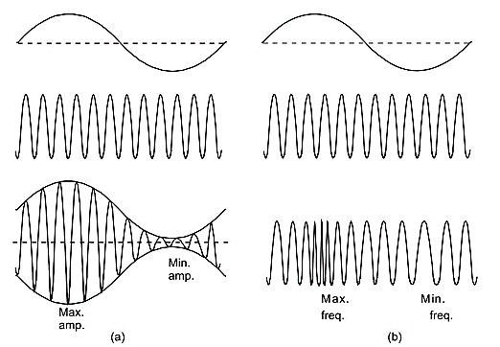
(a) Amplitude modulation (b) Frequency modulation

Slide 50
Suitability of AM for Video Signals
Amplitude Modulation is suitable for video signals for the following reasons:
In AM, detection of baseband signal from the modulated wave is very easy using a single diode rectifier and a simple low pass filter circuit. The circuit is of low price.
AM detector does not detect random changes in phase but detects the changes in amplitude. Hence output of the detector is free of phase noise.
Baseband signal is accomodated in two sidebands only and therefore bandwidth requirement is low. Maximum bandwidth for video signal could be ± 5 MHz, which is further reduced by using vestigial sideband type AM.
The type of AM used in TV is called Vestigial Sideband AM (AM VSB)

Slide 51
Suitability of FM for Audio Signals
Frequency modulation is used for transmission of audio signals due to the following advantages:
Signal to noise ratio is high in FM systems
Random changes in phase can be detected, but ears are not sensitive to phase changes and therefore this type of noise present in the audio output of the receiving system is harmless.
FM is power efficient, since it’s the sidebands that carry the information
Due to capture effect in FM system, weak interfering stations are fully suppressed.

Slide 52
Modulation of Colour Signals
Colour signals first modulate a subcarrier, using amplitude modulation suppressed carrier (AMSC).
The value of the subcarrier is 4.43 MHz in India.
Colour signals occupy smaller bandwidth of about 1.3 MHz
To save bandwidth further, upper side band is vestiged.
The reasons for using AMSC are
It will not be detected by the normal video demodulator of a monochrome receiver.
By not using carrier, a saving in power up to 67% is being made at the transmitter

Slide 53
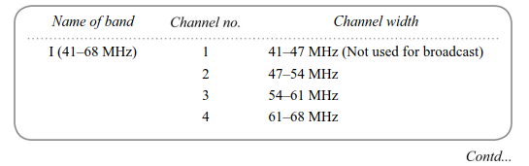
TV Channels used in India – VHF Bands

Slide 54
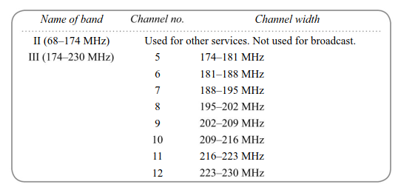

Slide 55
RF Spectrum
Radio frequency spectrum gives the frequency-wise amplitudes of various components of the baseband signal in the allotted channel width, relative to the radio frequency carrier.
The figure in the next slide shows a typical RF spectrum for the 4th channel (61 – 68 MHz) of TV transmission
RF carrier frequency is at 62.25 MHz
Lower sideband is attenuated below 61.50 MHz
The Upper sideband has full width of 5 MHz and attenuated beyond 67.25 MHz
Total bandwidth is 5.75 MHz
Colour subcarrier of 4.43 MHz is placed at 66.68 MHz in the spectrum of the modulated signal. I

Slide 56
RF Spectrum
Colour subcarrier of 4.43 MHz is placed at 66.68 MHz in the spectrum of the modulated signal. Its lower sideband is 1.3 MHz below, and upper sideband is 0.57 above the colour subcarrier
Audio modulated signal is also accommodated within the same channel width, the audio carrier being at 67.75 MHz with sideband within ±50 kHz
The remaining portion of the spectrum up to 68 MHz acts as a guard band for the next channel.

Slide 57
